Slide 1
Learning Objective
To learn what is identity theft and how to protect yourself
Agenda:
Announcements
Presentation

Slide 2
Announcements
Friday, October 9-Monday, October 12- BISD Holiday, ACC still has class on Monday

Slide 3

Announcements
https://www.youtube.com/watch?v=6XK9IOJh8go

Slide 4
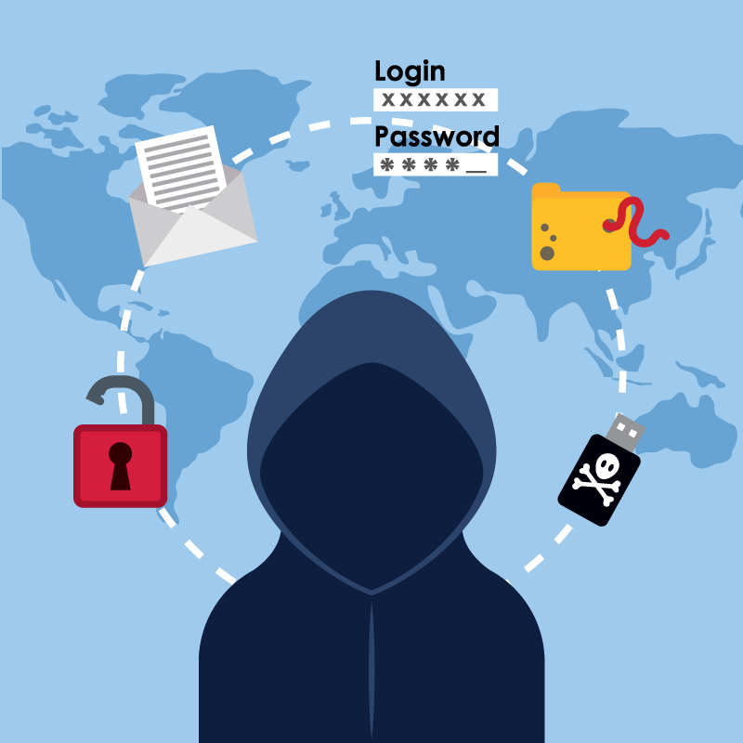
What is Identity Theft?
Identity theft is when a person steals your personal information including your name, Social Security number, birthdate, or bank information and use it to commit fraud. Thieves can use this information to open credit cards in your name
Even high school students can fall prey to identity thieves.

Slide 5

What can you do to keep safe
Practice Online Safety
Do not list personal information on social media, such as your birthday, full name, address, or even the name of your high school. Thieves can use this information to impersonate use.
Do not download files or open emails you do not recognize.
Only accept friend requests of people you know in real life.
Be careful with what photos you post.

Slide 6
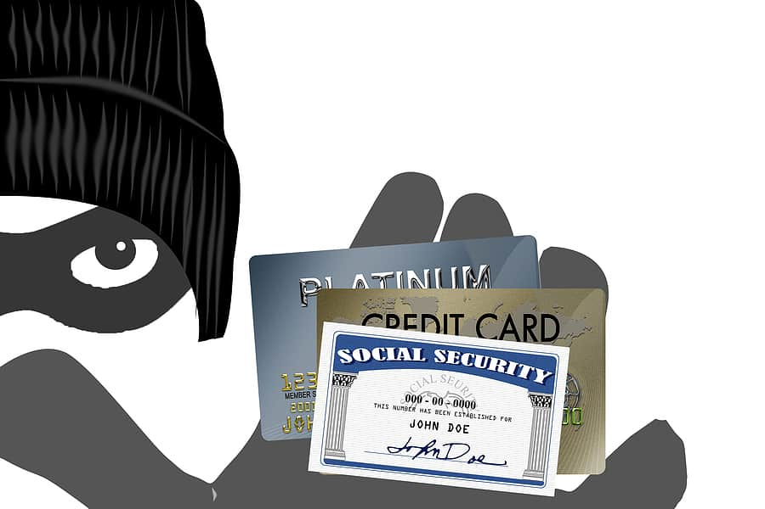
What can you do to keep safe
2. Protect your Social Security Number SSN
Do not carry your social security card in your wallet or purse. Lock it up somewhere safe and do not tell anyone your number unless your parents agree.

Slide 7

What can you do to keep safe
3. Create Strong Passwords
With all your social media sites or online shops, create strong passwords that cannot be guessed. If your Amazon password is your dog’s name, but on Instagram you mentioned your dog, you have just opened your self up to Identity Theft.
With all passwords, select a mix of letters and numbers.

